Slide 1

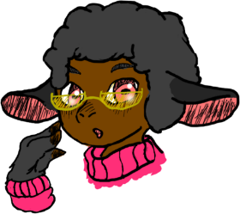

Everyone-Friendly Graphs
Simple Tweaks to matplotlib Graphs for the Color- and not-so-Colorblind
@thephantomderp
https://github.com/ThePhD/
NERD - December 2018, Boston Python

Slide 2
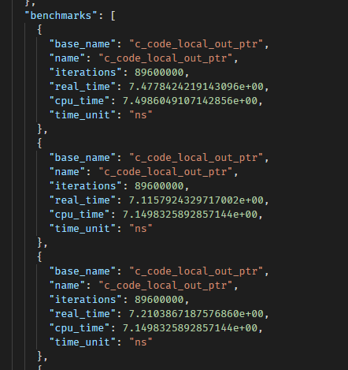
Statistical Benchmark Data
Mean/Median/Mode printouts are boring
Want visual indication of the above
plus standard deviation, visible showing of spread

Slide 3

Need Pretty Graphs!
Quick solution desired
Fast to iterate
Do not want to put things in spreadsheets and do the excel thing
Chose matplotlib + python to output my graphs

Slide 4
Step 0 – get files from places
Use argparse library to handle command arguments
Data in JSON or CSV (but mostly JSON, so CSV is actually not implemented)
Basic argparse stuff so we can get a file from the command line
import argparse parser = argparse.ArgumentParser(description=‘…’) parser.add_argument('-i', '--input', nargs='?’, default=‘blah.json’, type=argparse.FileType('r’)) args = parser.parse_args()

Slide 5
Step 1 – load JSON, parse JSON
Easiest part of the project
Turn JSON into a dictionary of name -> bucket of benchmark values
Store buckets in overarching categories, then store values based on entries
all_bars = benchmarks[“top level name”]
single_bar = all_bars[“single bar name”]
single_bar[“stats”], single_bar[“name”]
import json j = json.load(args.input) benchmarks = parse_json(j, …)

Slide 6
Step 2 – start using matplotlib
import matplotlib import matplotlib.pyplot as plt # … def draw_graph(name, category, benchmarks, …): figures, axes = plt.subplots() for bi, benchmark in enumerate(benchmarks): # calculate bar_y, bar_height mean = benchmark["stats"]["mean"] axes.barh(bar_y, mean, height=bar_height, align='edge’) axes.set_title(name) figures.tight_layout() figures.subplots_adjust(bottom=0.2)

Slide 7
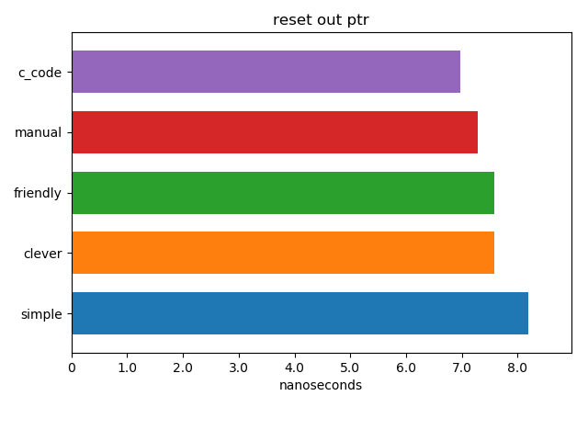
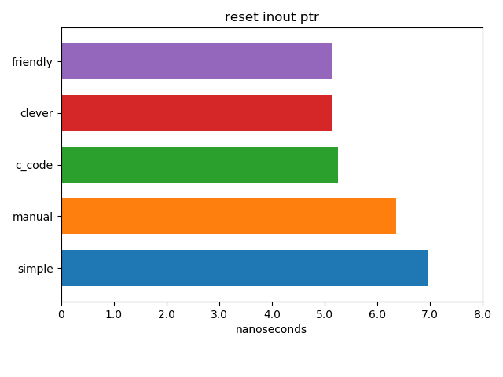
Graphs Mk. 0
Simple bar graph with basic labeling
… Wait a second, colors and names…?

Slide 8
Improvements
Desperately Needs Them

Slide 9

Improvements: Lounge<C++>
How many values?
Show error bars
Standard Deviation?
Show scatter of original values (superimposed? Maybe use transparency?)
Is lower or higher better?
Order graph by desired metric, make clear in axis

Slide 10
Color array: keep stable color names
Sort the benchmarks by bar name
Tag with incrementing integer id color_index, use to index into below array
Color stability between runs and between different graphs
# some color constants, to help us be pretty # yapf: disable data_point_colors = [ '#a6cee3', '#f255bb', ... ]

Slide 11
Apply color / edgecolor
color_index = benchmark["color_index"] color = data_point_colors[color_index] edgecolor = ‘#000000’ axes.barh(bar_y, mean, height=bar_height, xerr=stddev, linewidth=0.2, edgecolor=edgecolor, color=color, hatch=hatch, align='edge’)

Slide 12
Apply scatter with Transparency
xscatter = benchmark["data"] xlen = len(xscatter) yscatter = [ bar_y + random.uniform(…) for _ in xscatter ] scatter_alpha = 0.20 if xlen < 11 else … scatter = axes.scatter(xscatter, yscatter, color=color, edgecolor=‘#000000’, linewidth=0.5, alpha=scatter_alpha)

Slide 13
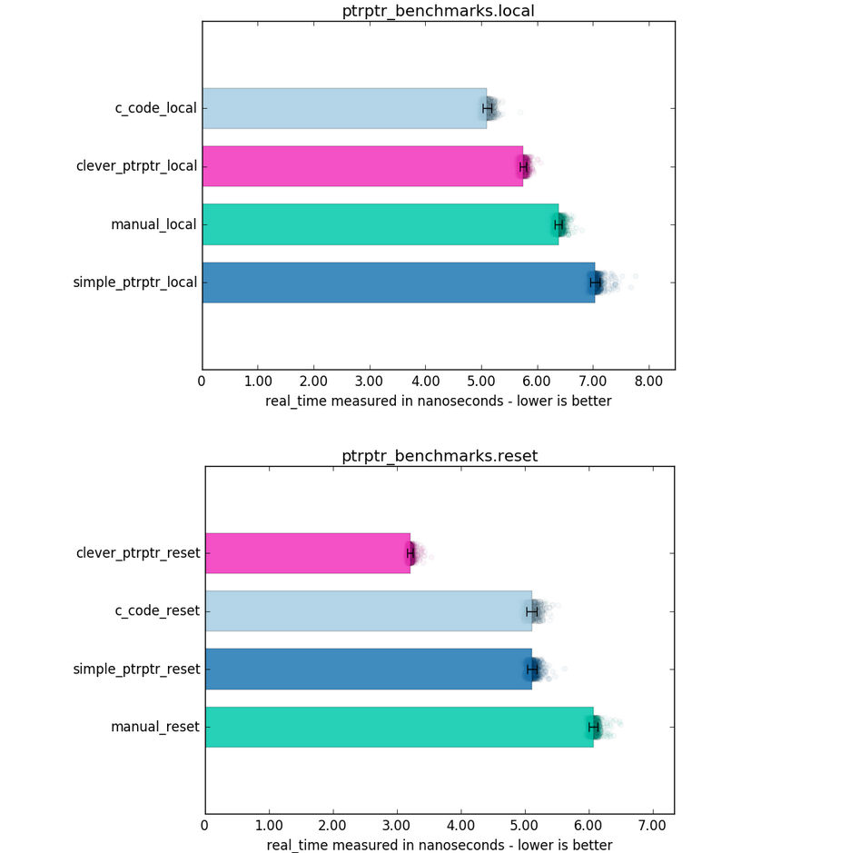
Graph Mk. I
Easier to read!
Value spread + error bars, colors for specific data points are sticky
All done! … Right?

Slide 14
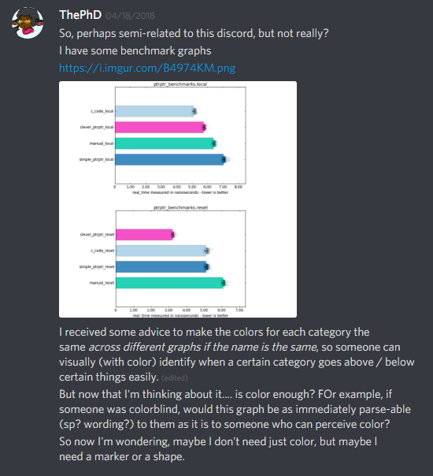


Right…?
Met someone in #include discord
includecpp.org/

Slide 15
Wrong.
Making it Better

Slide 16
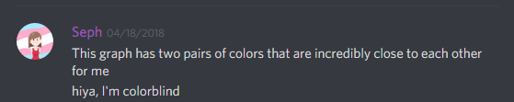
More to do!
Not Colorblind friendly in the slightest!
Seph started helping me, then Fred Tinguad, Olafur W., and Softwarebear…

Slide 17
More Improvements!
Change Colors
More differentiation
Shapes/Patterns
# some pattern/color constants, to help us be pretty # yapf: disable data_point_aesthetics = [ ('#a6cee3', '/’), ('#f255bb', ‘O’), ... ]

Slide 18
Use edgecolor plus hatch pattern
axes.barh(bar_y, mean, height=bar_height, xerr=stddev, linewidth=0.2, edgecolor=edgecolor, color=color, hatch=hatch, align='edge’, error_kw={ "capsize": 5.0, "mew": 1.2, "ecolor": 'black’, }, alpha=0.82)

Slide 19
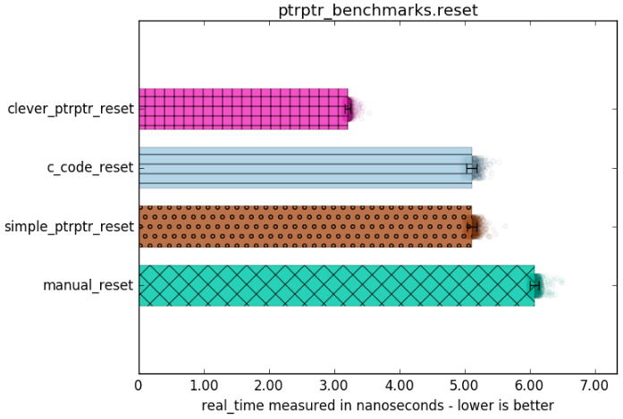
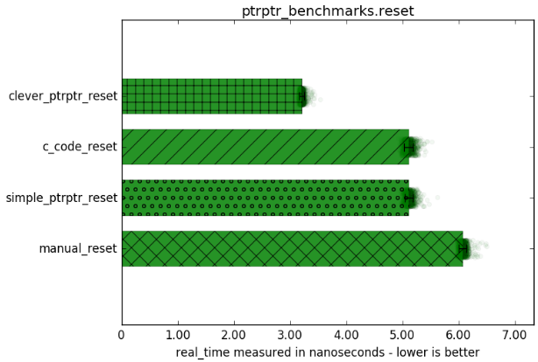
Still not quite right…

Slide 20
HSV to the Rescue
Default shapes too dark / harsh
darken the RGB colors, but not too hard
Convert Red Green Blue (RGB) to Hue Saturation Value (HSV)
Lower the V in HSV (also known as “Lightness”)
color = … colorhsv = matplotlib.colors.rgb_to_hsv( matplotlib.colors.hex2color(color)) # 35FF6A -> (53,255,106) colorhsv[2] *= 0.6 # decrease V value edgecolor = matplotlib.colors.hsv_to_rgb(colorhsv)

Slide 21
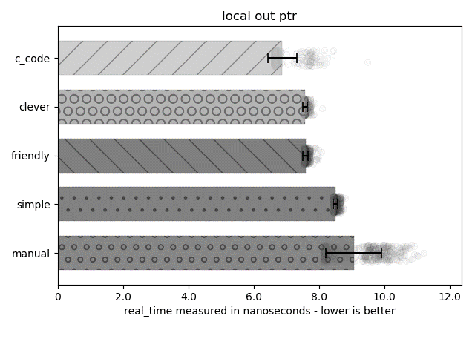
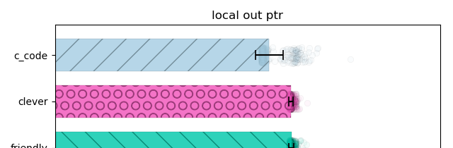
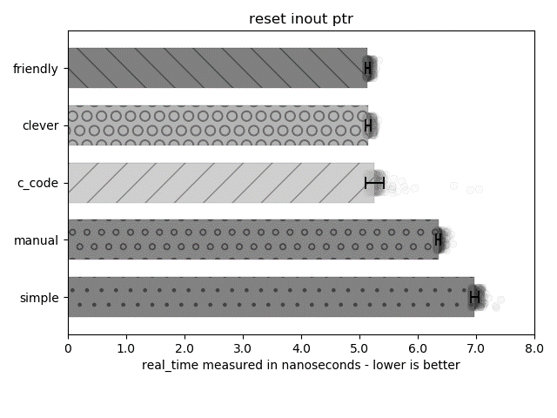
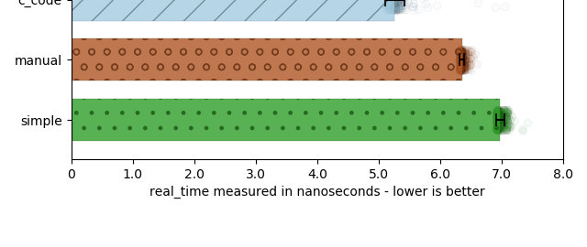
Beautiful. For Everyone.

Slide 22
Colorblind Friendly = Everyone Friendly
It started as being just a Colorblind investigation…
Accommodating disability brings gains beyond just feel-good cred
“I want to improve my bottom line”
Ask someone with greater challenges than yourself (colorblind, broken arm)
How they like it / handle it often makes it easier for the able-bodied too!

Slide 23


Thank You
@thephantomderp
https://www.patreon.com/thephd
https://www.linkedin.com/in/thephd
https://github.com/ThePhD/
For Listening!

